Slide 1

Slide 1
HIRING PROCESS ANALYTICS
BY SUSHILKUMAR AGALE

Slide 2

Project Description
In this project, I worked to analyze the hiring process data and derive meaningful insights to improve the company's hiring procedures. The main objectives were to understand gender distribution among hires, calculate the average salary, visualize salary distribution, departmental analysis, and position tier analysis.

Slide 3
Approach
using Microsoft Excel 2022 as my primary tool I followed a structured approach to analyze the hiring process data

Slide 4
Tech-Stack Used
Microsoft Excel 2022 Used for data manipulation, analysis, and visualization

Slide 5
Insights
Gender Distribution of Hires: The analysis that the company had hired males and females
Average Salary: The average salary offered by the company
Salary Distribution: The salary distribution was divided into class intervals understanding the distribution pattern
Departmental Analysis: A pie chart showed people working different departments.
Position Tier Analysis: understanding the distribution of positions across different tiers.

Slide 6
Result
Through this project, I gained a deeper understanding of the company's hiring process. The insights obtained from analyzing the data. I have enhanced my analytical skills by gaining proficiency . analyses on real-world datasets, identify patterns and trends in data, and draw insights that can be used to make informed decisions.

Slide 7
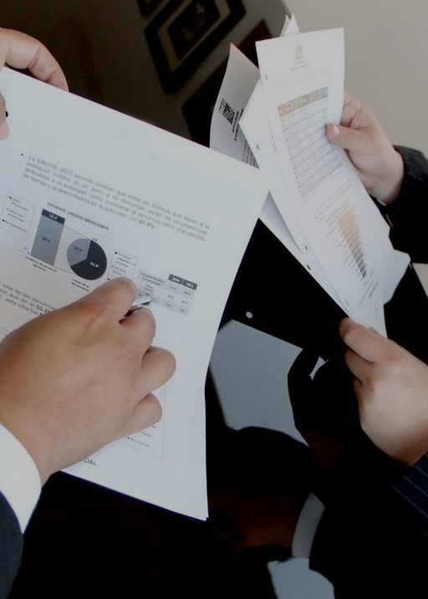
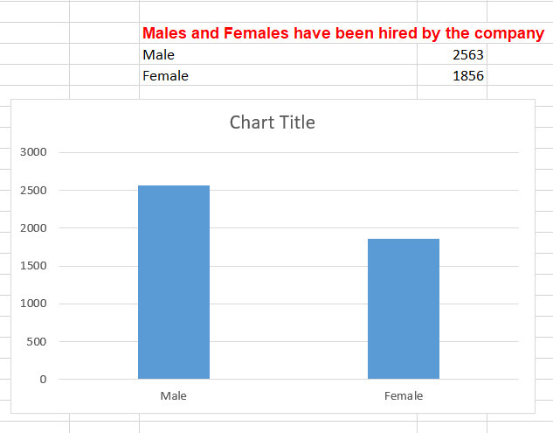

Slide 6

Slide 8
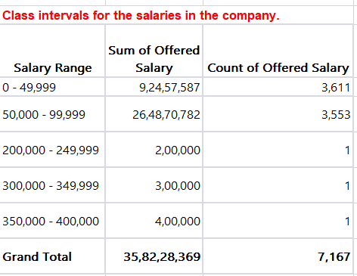
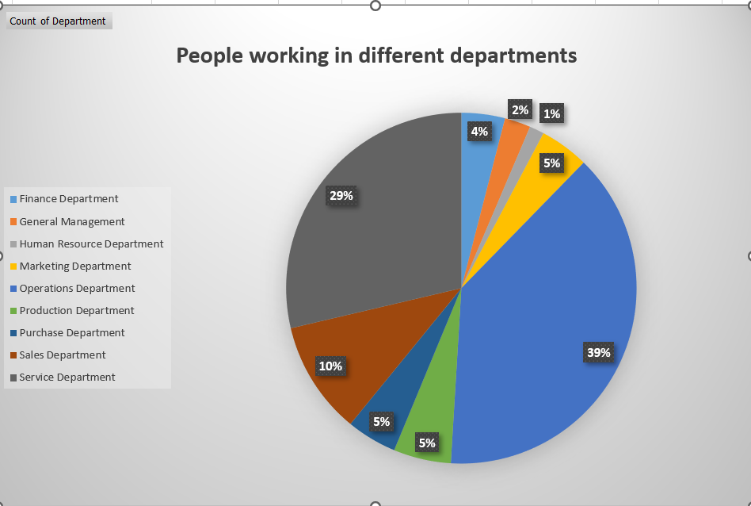
Slide 6

Slide 9
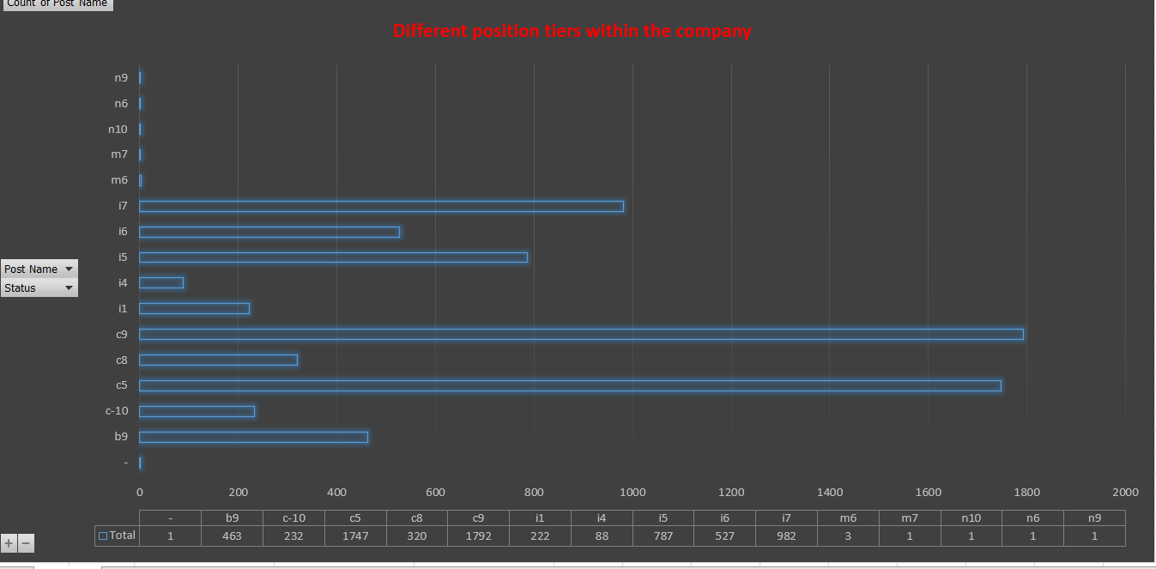
Slide 6

Slide 10

Slide 10
THANK YOU

